Slide 1
Identification and Classification of Military Aircrafts
UC: Aprendizagem Profunda para Visão por Computador
Professor: Tomás Brandão
Alunos: Beatriz Santos, João Ferreira, Rodrigo Sarroeira

Slide 2
Workflow
01
02
03
04
05
06
Goals
Methods
Data Preparation
Define the goals of the project
Describe the proposed methods
Dataset balancing, over and under sampling
Object Identification
Object Classification
Comparison of results
Object identification using transfer learning (SSD)
CNN using and not using Transfer Learning
Discuss the difference between the results

Slide 3
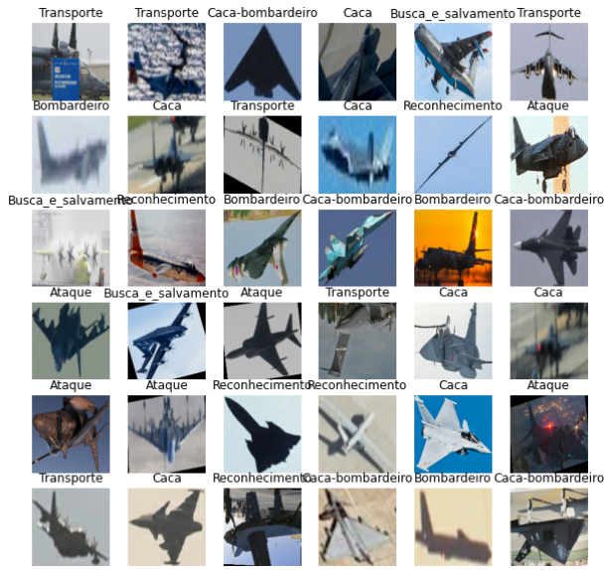
Data Understanding
Dataset form Kaggle
Contains 1440 images containing military aircraft from 40 different models
The dataset with 8GB
Contains cropped images labelled with the model of the plane
Contains images with bounding boxes, locating the planes

Slide 4
01
Goals

Slide 5
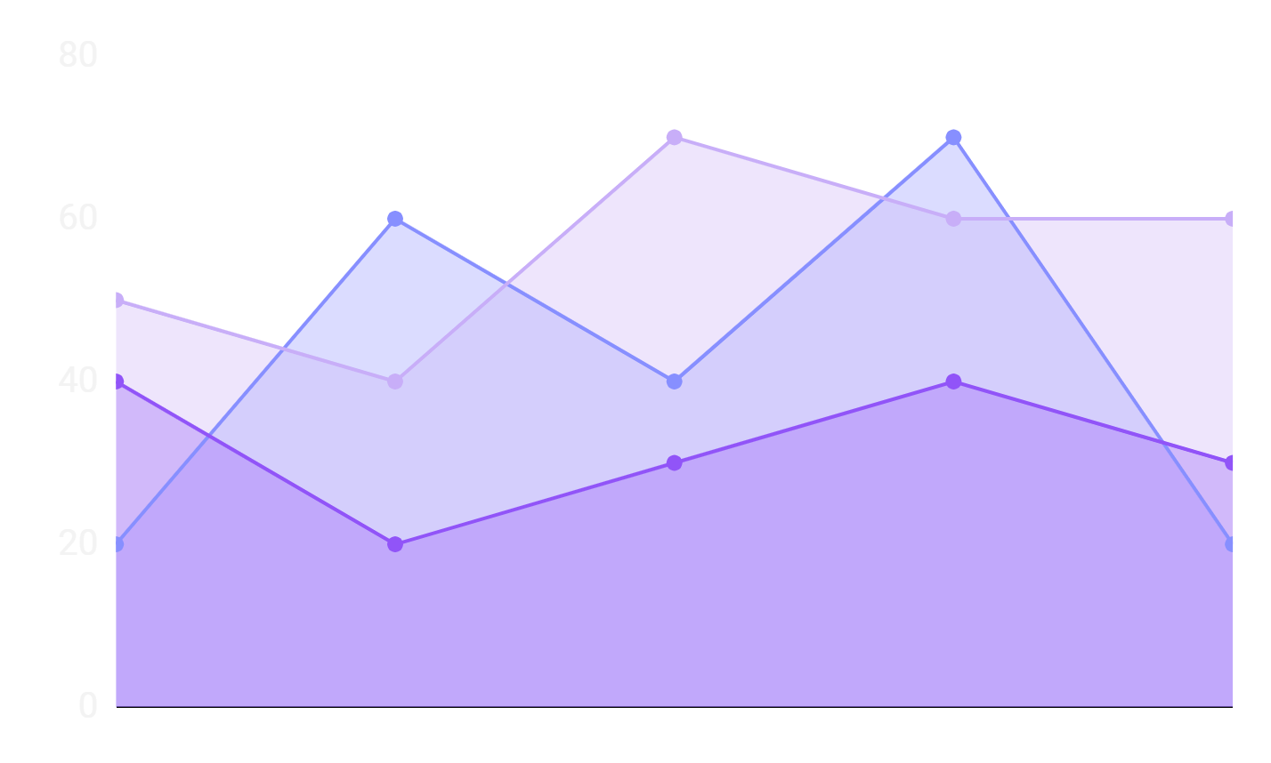
Main goals
Prepare the dataset to allow a better performance of the models
Create Scripts that can efficiently locate military aircraft in images
Define CNN models that efficiently classify military aircraft into 7 classes

Slide 6
02
Methodology

Slide 7
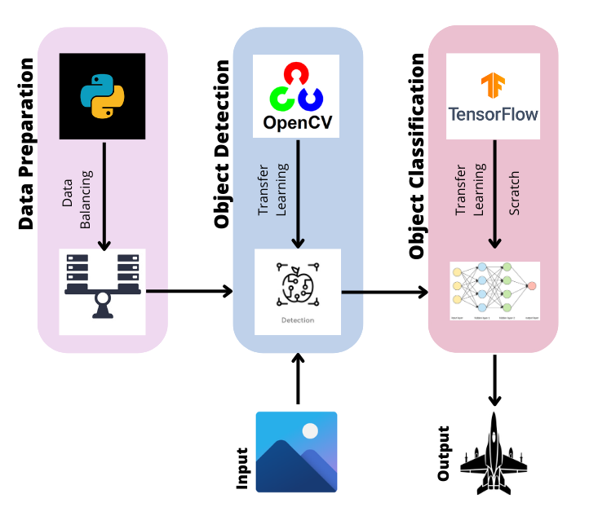

Slide 8
03
Data Preparation

Slide 9
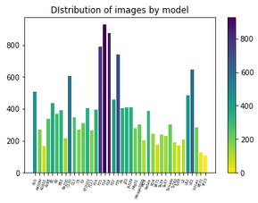
Initial Dataset: 40 airplane models

Slide 10
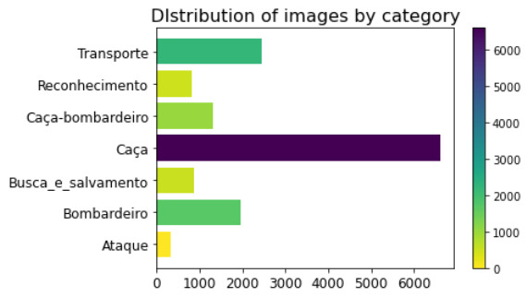
New Dataset: 7 groups of airplanes

Slide 11
Problem VS Solution
Problem
Solution
The classes are very unbalanced in terms of cardinality
Apply random methods to balance the dataset. Techniques of over and under sampling

Slide 12
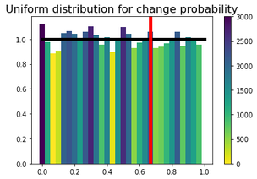

Slide 13
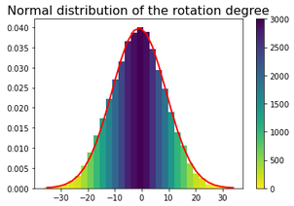

Slide 14
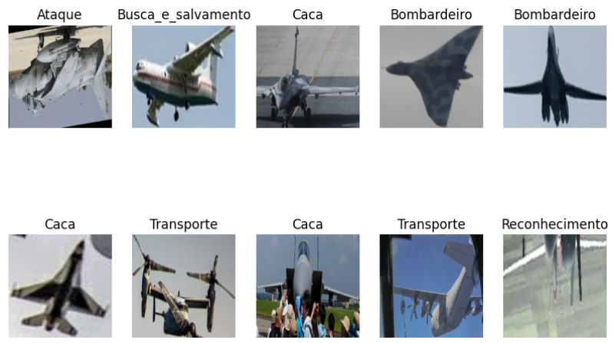

Slide 15
04
Object Identification

Slide 16
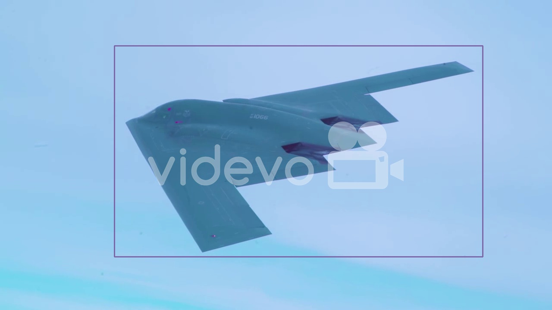
Military aircraft object Detection
SSD MobileNet V2
Transfer Learning
The problem at hand is too specific

Slide 17
Object Identification - Results
25%
36%
16%
IoU
Recall
TL: MobileNet

Slide 18
05
Object Classification

Slide 19
05.1
Scratch

Slide 20
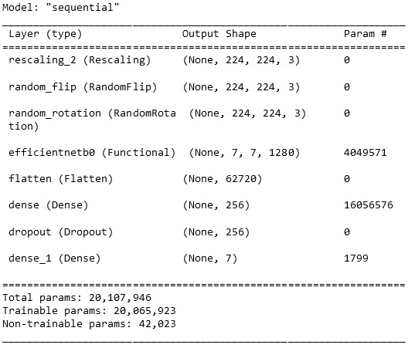
EfficientNet Structure

Slide 21
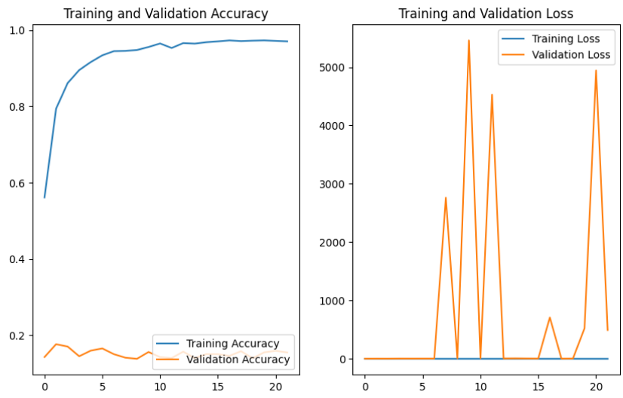
EfficientNet Training performance

Slide 22
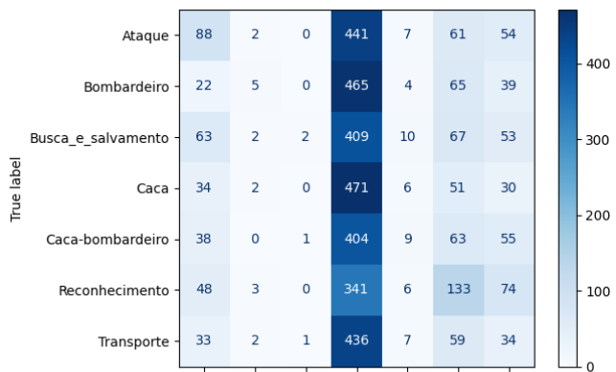
EfficientNet Confusion Matrix

Slide 23
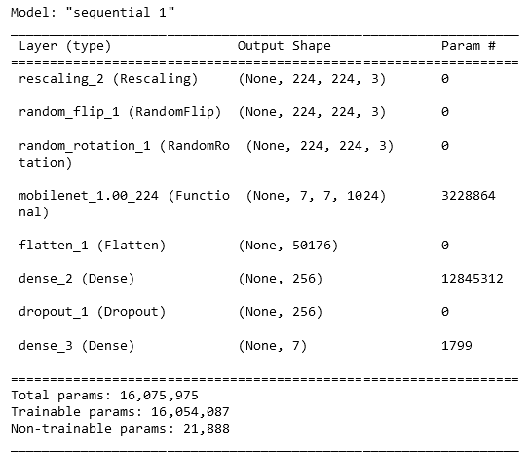
MobileNet Structure

Slide 24
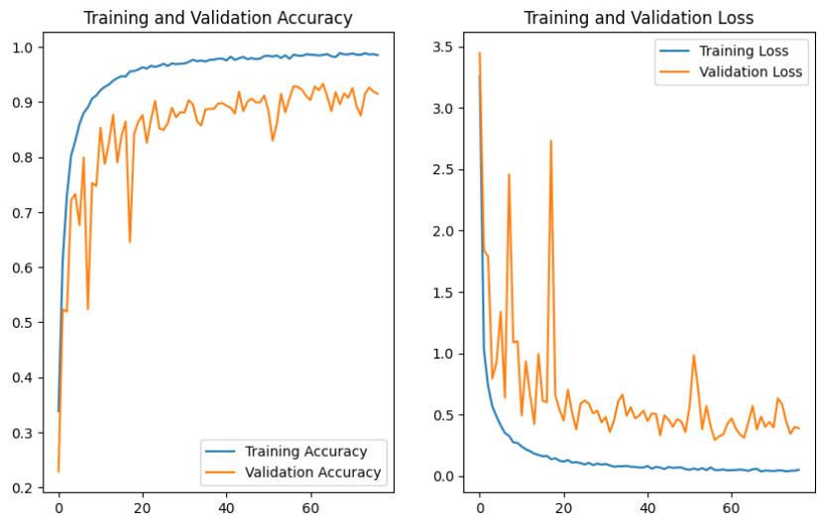
MobileNet Training performance

Slide 25
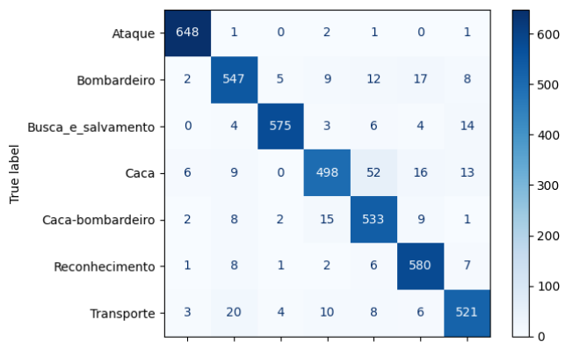
MobileNet Confusion Matrix

Slide 26
05.2
Transfer Learning

Slide 27
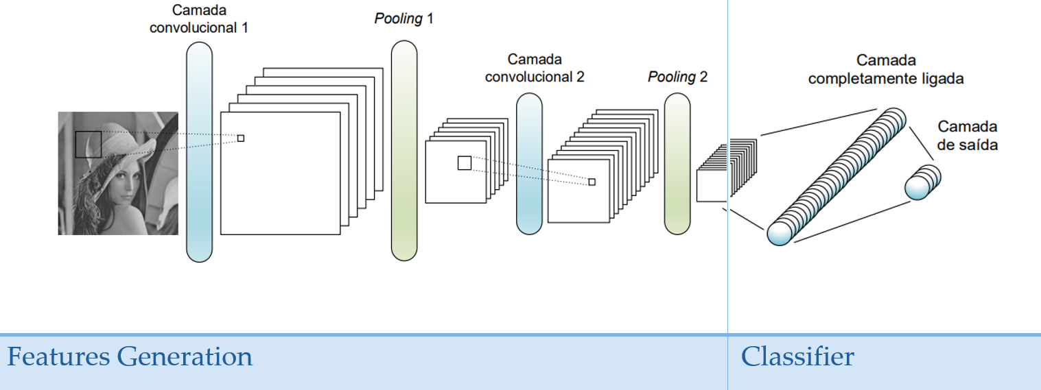

Slide 28
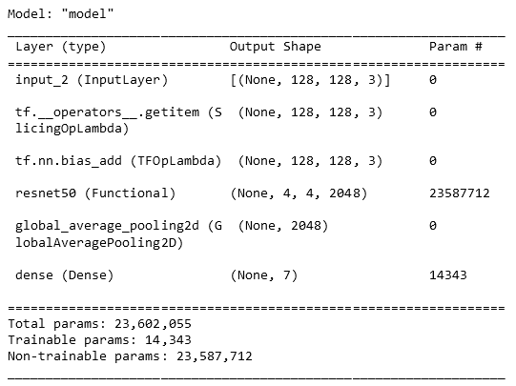
ResNet Structure

Slide 29
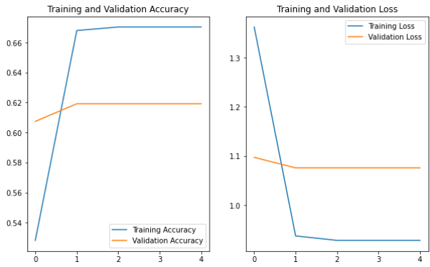
ResNet Performance

Slide 30
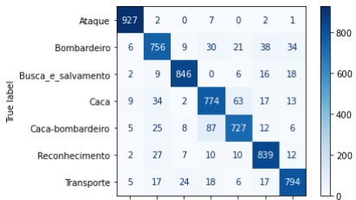
ResNet Confusion Matrix

Slide 31
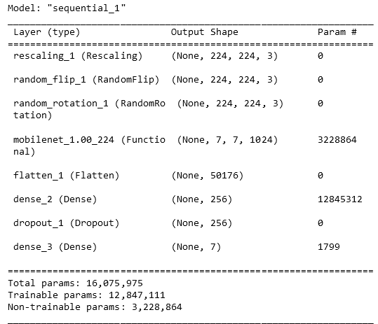
MobileNet Structure

Slide 32
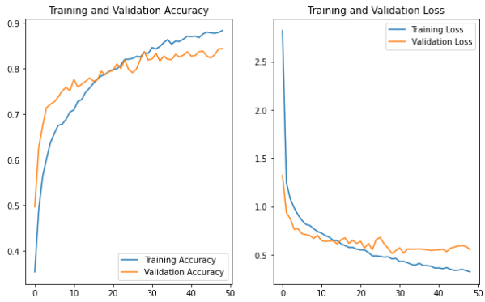
MobileNet Training Performance

Slide 33
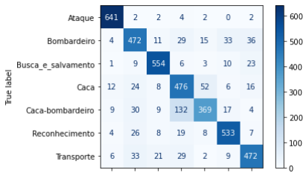
MobileNet Confusion Matrix

Slide 34
06
Comparison of Results

Slide 35
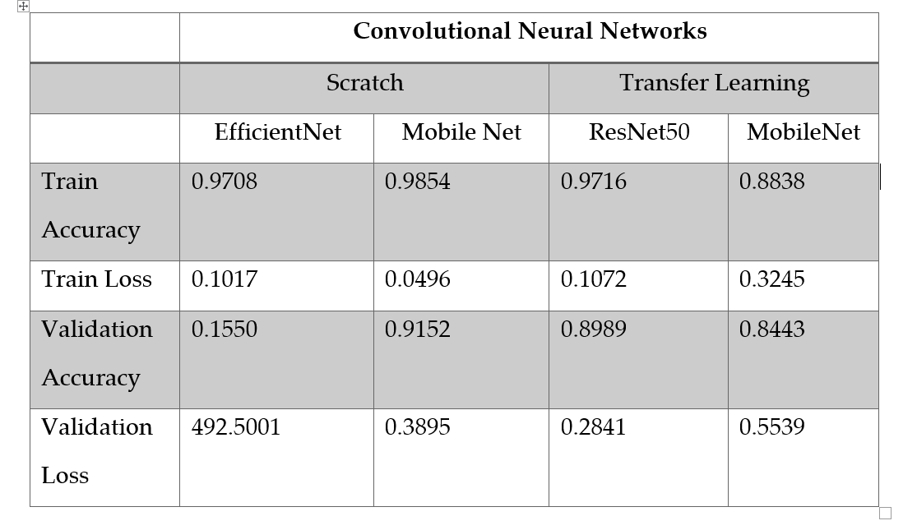
Metrics Evaluation

Slide 36
Models Accuracy
17.6%
92.9%
89.7%
83.7%
EffiicentNet
MobileNet
TL: ResNet
TL: MobileNet

Slide 37
07
Future Work

Slide 38
Ideas For Future Development
Gather more images
Create bounding boxes specific to the 7 classes
Train an object detector specific to our problem and classes
Train a ResNet50 model from scratch

Slide 39
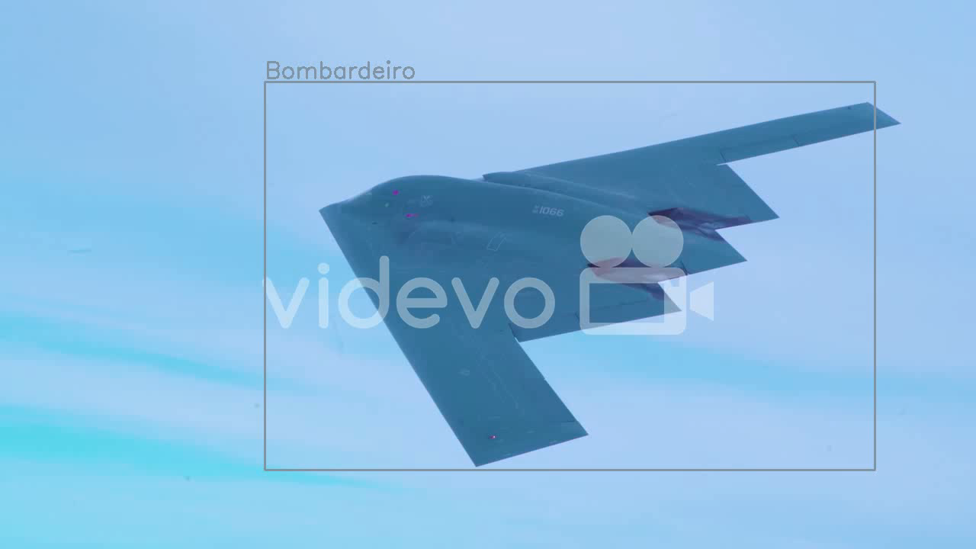

Slide 40
THANK YOU!

